Slide 1

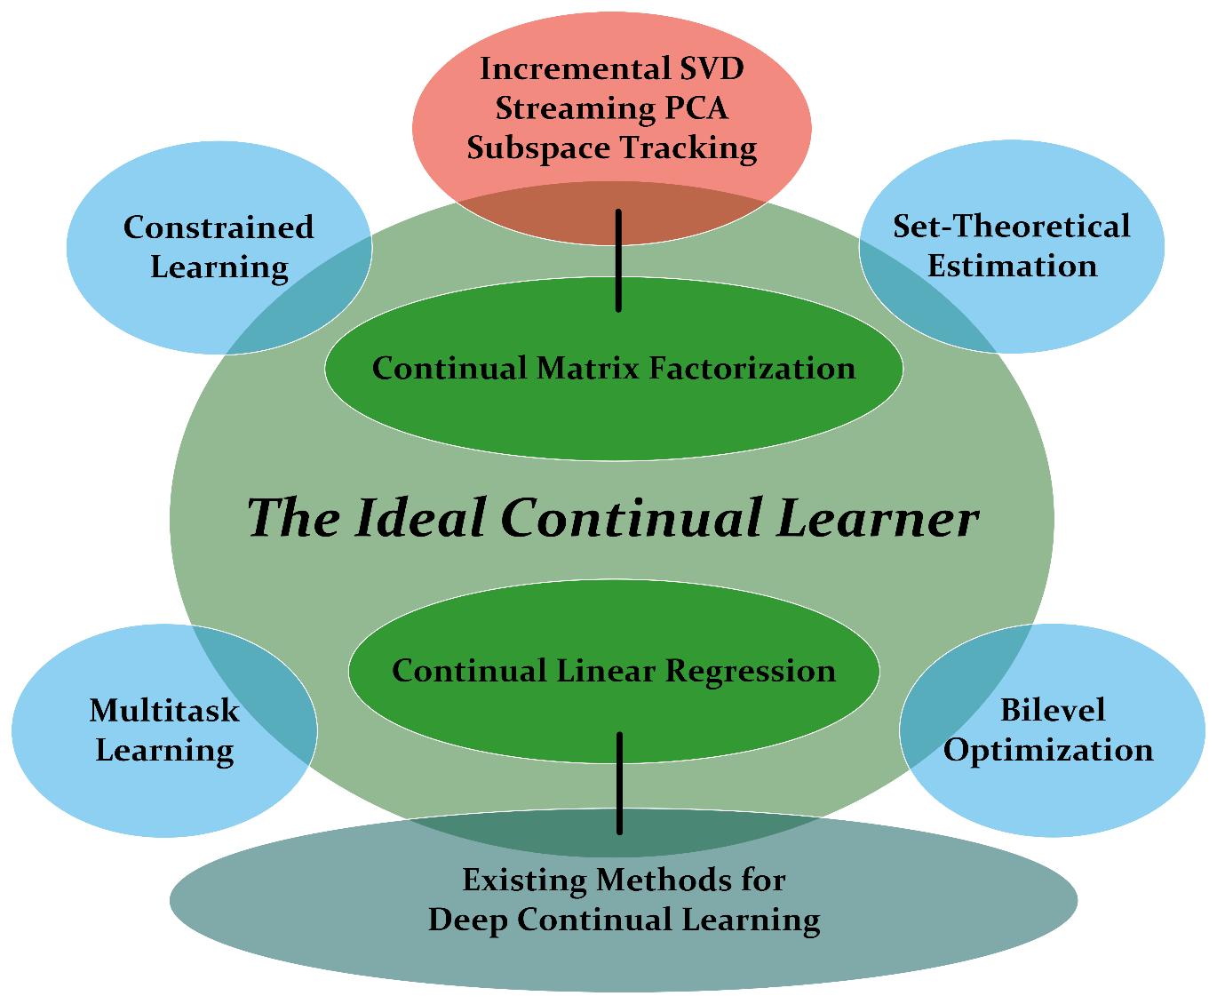
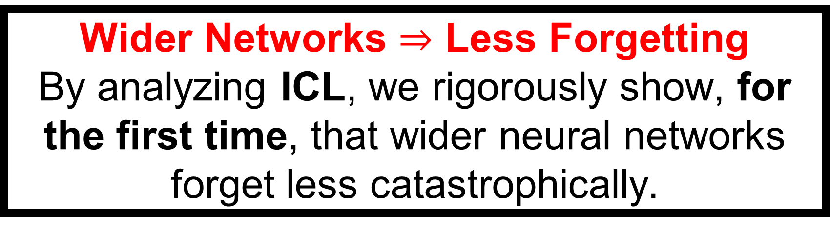
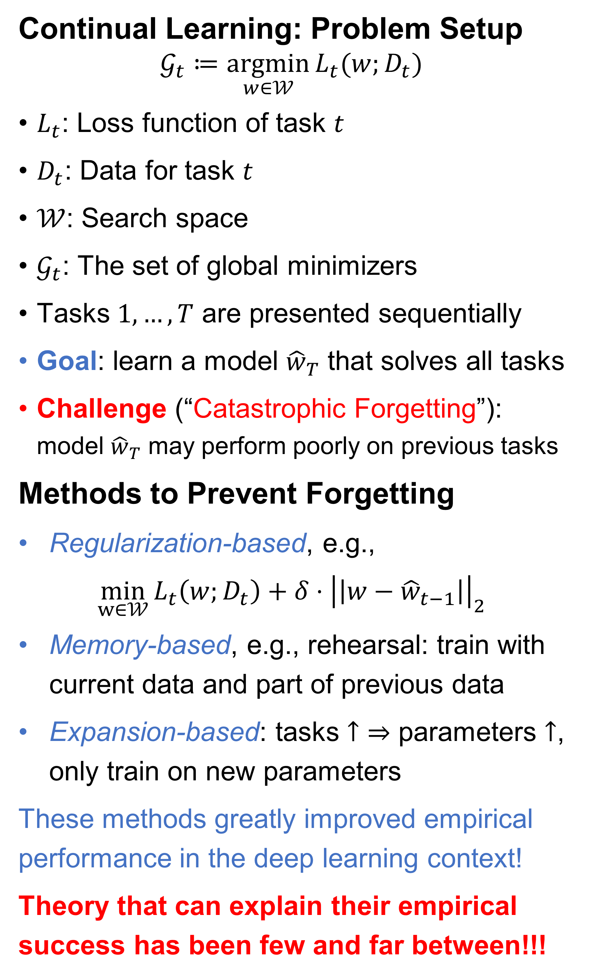
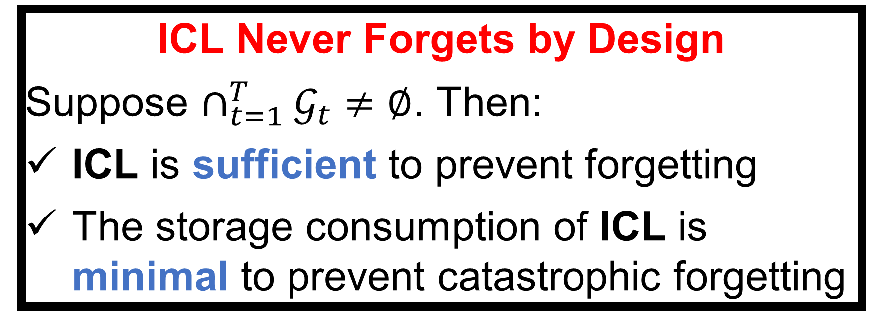

The Ideal Continual Learner: An Agent That Never Forgets
Liangzu Peng¹ Paris V. Giampouras¹ René Vidal^{2,3}
¹Johns Hopkins University ²University of Pennsylvania ³NORCE Norwegian Research Centre, Norway
Continual Learning: Problem Setup
$$𝒢_{t}≔\underset{w∈𝒲}{argmin}{L_{t}(w;D_{t})}$$
$L_{t}$: Loss function of task $t$
$D_{t}$: Data for task $t$
$𝒲$: Search space
$𝒢_{t}$: The set of global minimizers
Tasks $1,…, T$ are presented sequentially
Goal: learn a model ${\hat{w}}_{T}$ that solves all tasks
Challenge (“Catastrophic Forgetting”): model ${\hat{w}}_{T}$ may perform poorly on previous tasks
Methods to Prevent Forgetting
Regularization-based, e.g.,
$$\min_{w∈𝒲}{L_{t}\left(w;D_{t}\right)+{δ⋅\left|\left|w−{\hat{w}}_{t−1}\right|\right|}_{2}}$$
Memory-based, e.g., rehearsal: train with current data and part of previous data
Expansion-based: tasks $↑$ $⇒$ parameters $↑$, only train on new parameters
These methods greatly improved empirical performance in the deep learning context!
Theory that can explain their empirical success has been few and far between!!!
The Ideal Continual Learner (ICL)
With $𝒦_{t}≔𝒲$, ICL is a method that solves
$$𝒦_{t}≔\underset{w∈𝒦_{t−1}}{argmin}{L_{t}(w;D_{t})}$$
sequentially, for $t=1, 2,…, T$.
Take-Away Messages from ICL
Acknowledgements: Work supported by the project ULEARN “Unsupervised Lifelong Learning” and co-funded under the grant number 316080 of the Research Council of Norway.
History & Future (Figure in the middle)
Connections of ICL to other topics shed light on historical remarks & research avenues
ICL Never Forgets by Design
Suppose $∩_{t=1}^{T}𝒢_{t}≠∅$. Then:
ICL is sufficient to prevent forgetting
The storage consumption of ICL is minimal to prevent catastrophic forgetting
All Roads Lead to Rome
ICL can be viewed as a regularization-based, memory-based (projection-based), or expansion-based method. Put conversely,
these methods, designed via different insights, are all Ideal Continual Learners.
Rehearsal is an Ideal Continual Learner
We prove the first generalization guarantee for rehearsal, a highly performant memory-based method
Bunch & Nielsen (1978)
Oja (1982), Yang (1995)
Witsenhausen (1968)
Combettes (1993)
Kieffer et al. (1998)
Chamon et al. (2022)
Wider Networks $⇒$ Less Forgetting
By analyzing ICL, we rigorously show, for the first time, that wider neural networks forget less catastrophically.
Conclusion & Limitation
ICL is the first general theoretical framework that never forgets by design
Implementing ICL exactly is challenging, but approximating ICL is possible
Caruana (1998)
Vicente & Calamai (1994)

